Slide 1
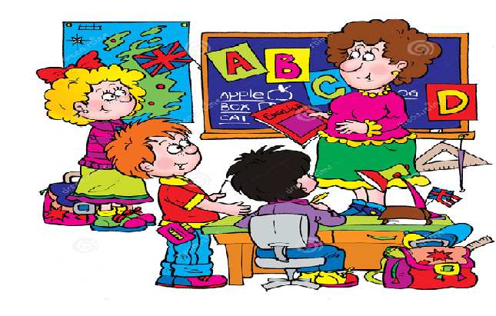
Welcome to our English class!

Slide 2

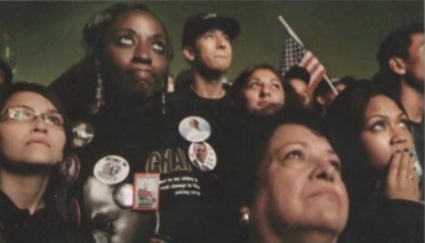
Task 1: Look at the photo and answer the questions
1. Who can you see?
3. How do they feel?
2. What are the people doing?

Slide 3
Task 1: Reorder the paragraphs to make a complete text
A | I walked around the park outside the center. Although it was November, it was a warm night. The atmosphere was wonderful. When I took this photo, everybody was looking at the TV screens waiting for the election results.
B | I was watching Obama’s victory through the faces of all these people, African, Hispanic, Chinese, white. At about 11 o’clock the results were announced, and everybody went crazy. People started laughing, shouting, and crying. But when Obama made his speech they all became quiet and emotional. There was only one place to be on the planet that night – and I was there.
C | Some people were quietly holding hands and smiling – others were tense and nervous. They felt that it was their moment. Suddenly, I realized that this was a better place to be than inside.
D | On November 4th, I arrived in Chicago late in the evening. I wanted to photograph Barack Obama and his family in the convention center, but when I got there, I discovered that I didn’t have my press pass and I couldn’t go inside.

Slide 4

Task 1: Reorder the paragraphs to make a complete text
A MOMENT IN HISTORY
ANSWER
D – A – C – B

Slide 5

What’s the text about?
moment (n): /'məʊmənt/ very short period of time

Slide 6
Read the text again. Choose the best summary
A. Tom Pilston went inside the convention center in Chicago to photograph Obama. He felt so happy to hear the election results from the radio.
B. Tom Pilston arrived in Chicago and took alot of photographs of Obama and his family. He had a chance to see people showing their love to the new president.
C. Tom Pilston went to Chicago to take the photographs of Obama and his family. He couldn’t go inside the center. Then, he had a chance to see people with different kinds of feelings listening to the election results.
C. Tom Pilston went to Chicago to take the photographs of Obama and his family. He couldn’t go inside the center. Then, he had a chance to see people with different kinds of feelings listening to the election results.

Slide 7
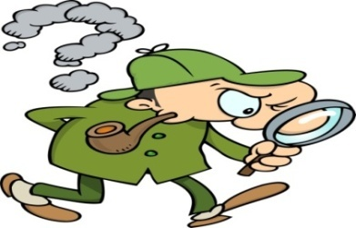
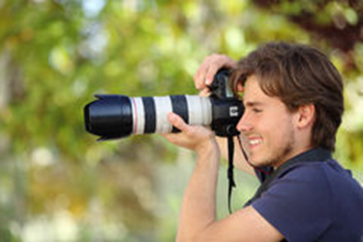
vocabulary
photograph (n) /'fəʊtəgra:f/ = photo:
a picture made by a camera
=> take a photograph of sb/sth
=> photographer (n): /fə'tɒgrəfə(r)/
a person who takes a photograph

Slide 8
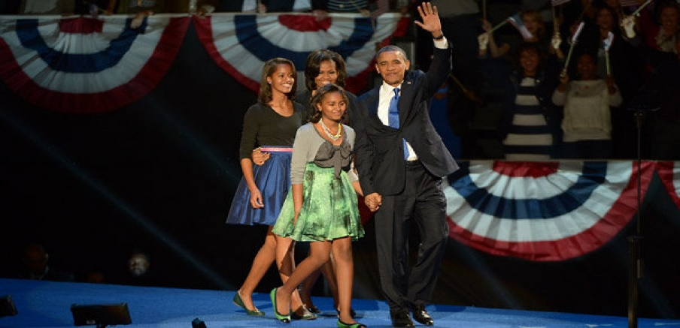
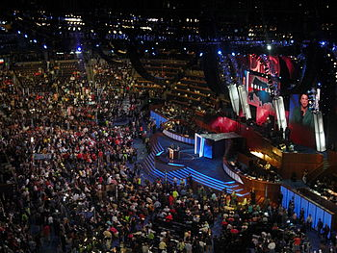
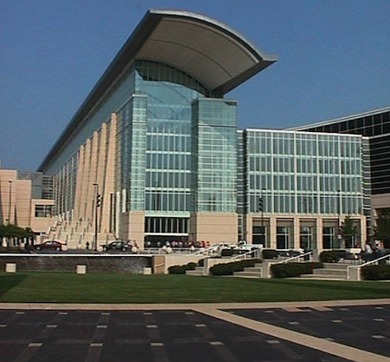
vocabulary
convention (n): /kən'venʃn/
an official agreement between countries or leaders
=> convention center (n)

Slide 9
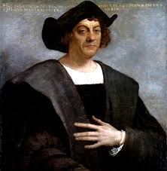
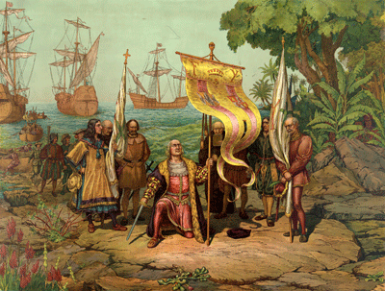
vocabulary
discover (v): /dɪ'skʌvə(r)/
to find out about something
for the first time
Christopher Columbus discovered America on 12th October, in 1492.

Slide 10

vocabulary
press (n): /pres/
- people (reporters and photographs) for
newspapers or magazines
- newspapers, magazines and radio and
TV news reports
Pass (n): /pa:s/
An official document
that shows you have the right to enter or leave a place.
=> A bus pass, boarding pass
=> Press pass (n)

Slide 11
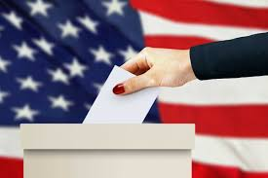
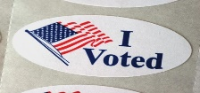
vocabulary
election (n) /ɪ'lekʃn/
the process of choosing a person or a group of people for a position, especially for a political position by voting.
=> elect (v)

Slide 12
vocabulary
result (n): /rɪ'zʌlt/
a thing that is caused or produced
because of something else.
E.g: He made a big mistake.
As a result, he lost his job.

Slide 13
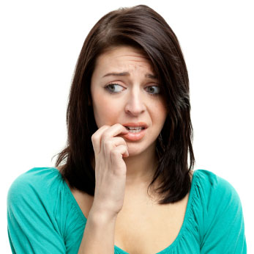
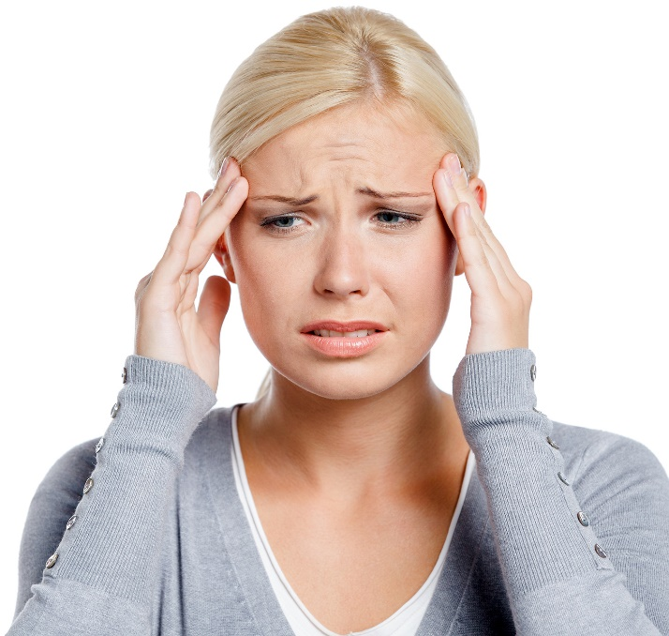
vocabulary
nervous (adj): /'nɜ:vəs/
worried or afraid of what might happen
E.g: She feels nervous because of the exam.
tense (adj): /tens/
nervous and not able to relax

Slide 14

vocabulary
announce (v): /ə'nəʊns/
officially tell people about something
=> announcement (n)

Slide 15
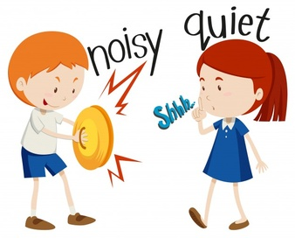
vocabulary
quiet (adj) /'kwajət/
making very little noise, not taking

Slide 16
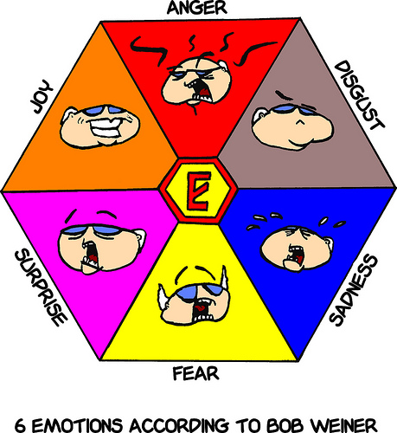
vocabulary
emotion (n) /ɪ'mouʃn/
a strong feeling (such as love, anger, hate or fear)
=> emotional (adj)

Slide 17
Read the text again and answer the questions:
1. Why did Tom Pilston go to Chicago?
=> Because he wanted to photograph Obama and his family.
2. Why couldn’t he take a photograph of Obama?
=> Because he didn’t have a press pass to go inside the convention center.
3. What was the weather like?
=> It was a warm night.

Slide 18
4. Where did he take this photo?
=> He took this photo outside the convention center.
5. Where could the people see the election result?
=> People could see the election results on the TV screens.
6. Was he sorry that he couldn’t go inside the center?
=> No, he wasn’t.
7. What happaned when Obama won?
=> Everybody went crazy.

Slide 19
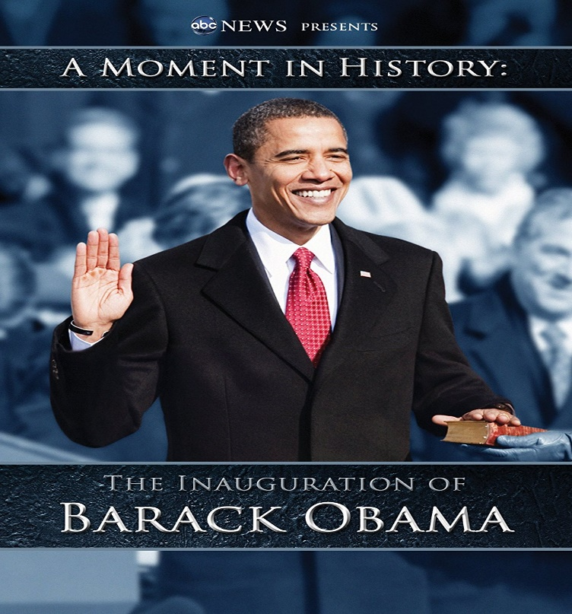
What’s happening?
People were looking at a screen in Chicago to see if Barack Obama had won the election on November 4, 2008.

Slide 21
Next term, they will be wearing a new uniform.
started
will finish
now
present
this term
The students are wearing an old uniform.
will start
will finish
future
next term
The students will be wearing a new uniform.

Slide 22
1. Next term, they will be wearing a new uniform.
Future Continuous
S
will be + V-ing
6p.m
now
9p.m
today
We are studying English at VUS.
6p.m
at this time
9p.m
next Thursday
We will be studying English at VUS.
=> An action in progress at a specific time in the future

Slide 23
Future Continuous
Task 2: Make sentences about what George will be doing at the times given.
7.15 | shower
7.50 | breakfast
8.40 | catch bus to school
8.55 | arrive at school
10.30 | maths lesson
=> At 7.15 tomorrow, he’ll be having a shower.

Slide 24
2. I’m flying to Hanoi tomorrow.
Future Continuous
=> I will do the activity in the near future.
I’ve already had a plan to fly to Hanoi.
=> I will be flying to Hanoi tomorrow.
=> to talk about planned events or events that we expect to happen.
=> Next term, we will be meeting more regularly.

Slide 25
Future Continuous
Task 3: Write sentences about these people’s plans.
1. I’m going to the supermarket later.
2. He’s visiting his grandparents next month.
3. She’s watching the football match on TV tonight.

Slide 26
3. When will you leave?
Future Continuous
=> Direct question
=> Can you let me know
when will you leave?
=> Can you let me know when you will leave ?
=> Can you let me know when you will be leaving ?
=> When will you be leaving ?
to make polite enquiries (ask about somebody’s plans politely)

Slide 27
Task 4: Rephrase the questions to make polite questions.
Future Continuous
1. What time are you leaving school?
=> What time will you be leaving school?
2. Are you going to stay overnight?
=> Will you be going to stay overnight?
3. What do you plan to do this evening?
=> What will you be doing this evening?

Slide 28
Future Perfect
4. By the end of the year, they will have made their school better.
S
will have + V-3/ -ed
started
now
They have made the school better.
now
the end of the year
past
present
future
They will have made the school better.
=> to talk about a completed action in the future

Slide 29
Future Perfect Continuous
5. By the end of this week, they will have been running
S
will have been + V- ing
the new school council for a whole term.
past
the end of this week
They will have run the school council for a whole term
now
the end of this week
past
present
future
They will be running the school council.

Slide 30
Future Perfect Continuous
a whole term
the end of this week
past
…will have run… for a whole term.
…will be running…
=> …will have been running for a whole term.
=> to say how long an action will have been in progress in the future => usually used with for + a period of time.

Slide 31

Task 3: Explain the meaning of these sentences
At 4p.m, we’ll watch the film.
At 4p.m, we’ll be watching the film.
By 4p.m, we’ll have watch the film.
By 4p.m, we’ll have been watching the film for an hour.

Slide 32
Practice: Grammar builder p.122

